Slide 1
RAYALASEEMA UNIVERSITY KURNOOL
D. NAGA VENKATAKALYANI
b.sc(mpcs)
21360008004

Slide 2
PROJECT NAME
UNCOVERING VOICES OF DIGITAL AGE OF A SOCIAL MEDIA ANALYSIS

Slide 3
UNCOVERING VOICES OF DIGITAL AGE OF A SOCIAL MEDIA ANALYSIS
TEAM ID : LTVIP2024TMID14095
TEAM SIZE : 5
TEAM LEADER : EDIGA SARASWATI
TEAM MEMBER : SHAIK HEENA BEE
TEAM MEMBER : D. NAGA VENTAKATAKALYANI
TEAM MEMBER : DASARI ANGEL PERSIS
TEAM MEMBER : PEMARAPOGU SWETHA

Slide 4
ConTENTS
ABSTRACT
INTRODUCTION
SOCIAL MEDIA ANALYSIS
NEED FOR SOCIAL MEDIA ANALYSIS
PROCESS OF SOCIAL MEDIA ANALYSIS
BENEFITS OF SOCIAL MEDIA ANALYSIS
CONCLUSION

Slide 5
ABSTRACT
As a result of the availability of web-based application programming interfaces (APIs) for social networking sites, the study of social media has become a major research and business practice. This environment is evolving rapidly due to market demands and enormous applications. This paper presents a comprehensive review of leading social media analytics tools available for various social networking platforms. A comparative analysis has been carry out for the free and subscription based tools to judge their suitability for specific organisation. Various challenges are faced by businesses in adopting social media analytical tools to support the knowledge based business strategies. Correspondingly, the present day corporate challenges from the perspective of social media analytics in its adoption for corporate decisions have been outlined. This work will be very much useful for organisations in identifying the various tools available in the market, which may help them take knowledge based strategic decisions

Slide 6
INTRODUCTION
With Rapid increase in use of Internet and Mobile Communication , people are doingmore and more online activities . Due to this , there has been creation of widespreadsocial media network with increased awareness and responsiveness . With usage ofsocial media platforms like Faceboook , Twitter , Youtube , Quora , Skype , Redditetc , customers can connect with each other online and share their views about variousproducts and services used by them. Because of this social media data clearly givesthe main , richest and most active evidence of human behaviour , which can bringnew oppurtunities to understand indiviuals groups and society.

Slide 7
SOCIAL MEDIA ANALYSIS ;
Social media analytics is the process of collecting and analyzing audience data shared on social networks to improve an organization's strategic business decisions.
Social media can benefit businesses by enabling marketers to spot trends in consumer behavior that are relevant to a business's industry and can influence the success of marketing efforts.
Another important example of how social media analytics supports marketing campaigns is by providing the data to quantify the return on investment (ROI) of a campaign based on the traffic gained from various social media channels.

Slide 8
NEED FOR SOCIAL MEDIA ANALYSIS
In the early days of social media, PR agencies would monitor customers’ posts on a business’s own website in an attempt to identify and manage disgruntled customers . With the explosion in the number of social media sites and the volume of use on them , this is not nearly enough. Consider the prevalence of social media: -¿ Social networking is the most popular online activity -¿ More than 90 percent of adults use social media regularly But even this statistics fail to provide a full account of inﬂuence that social media is having . The amount of information seen in a day gives a more startling indication of social media’s enormous inﬂuence Businesses are also able to improve upon their performance measurement initiatives with the help of social media analytics. In addition, social media analytics also provide useful insights to the business functions like: a measurement of eﬀectiveness of advertising campaigns collection of insights on customer needs and preferences distinction of brand perceptions d collection of feedbacks related to product performance and capture of data on market trends related to various aspects of businesslike promotion and sales, customer relationships, public relationships and product expansion.

Slide 9
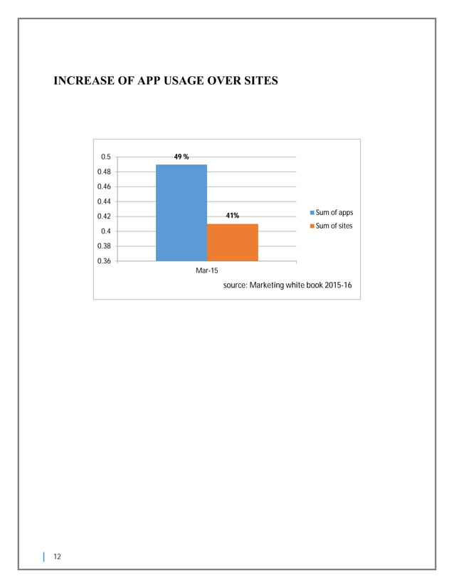

Slide 10
PROCESS OF SOCIAL MEDIA ANALYSIS
The process of Social Media Analytics consists of given below stages :
Data Capturing :
This stage is concerned with obtaining suﬃcient social media data by tracking, archiving relevant data and collecting relevant information from diﬀerent sources of social media . For a business engaged in social media analytics, the capture stage allows it to identify conversations on social media platforms related to its activities and interests. This is done by collecting massive amounts of relevant data across hundreds or thousands of social media sources using news feeds, APIs, or by crawling. The capture phase covers popular platforms such as Facebook , Twitter, LinkedIn ,YouTube , Pinterest , Google + , Tumblr , Foursquare, etc. As well as smaller, more specialized sources such as Internet forums, blogs and microblogs, Wikis, news sites ,picture sharing sites, podcasts, and social bookmarking sites. Enormous amounts of data are archived to meet businesses’ various needs .The capture stage must balance the need for ﬁnding information from all quarters with focusing on sources that are most relevant and authoritative to assist in more reﬁned understanding .

Slide 11
Data Understanding :
The interpretation phase is the next step in the process of social media analytics. This stage selects suitable modelling data, eliminates inaccurate, low quality data, and uses various advanced data analytical techniques to examine and get insights from the extracted data . Once a business has collected the conversations related to its products and operations, it must next assess their meaning and generate metrics useful for decision making. To gain useful insights from the cleaned data, various statistical methods and other techniques are used. As the capture stage gathers data from multiple sources, before conducting any substantive analysis, a signiﬁcant portion can be noisy and has to be removed.
DATA PRESENTATION :
The last or the ﬁnal stage in the above process is the presentation stage. This stage involves displaying the ﬁndings from the 2nd step in a expressive way. The results of various analytics are compiled, interpreted and presented to users in a format that is simple to understand. Various visualization techniques may be used to present useful information. One of the most commonly used interface designs is the visual dashboard, which aggregates and displays information from various sources. Sophisticated visual analytics go beyond simply displaying information. By supporting customized views for diﬀerent users, they help make sense of large volumes of information, including patterns that are more apparent to people than machines. Data analysts and statisticians may add extra support during this stage.

Slide 12
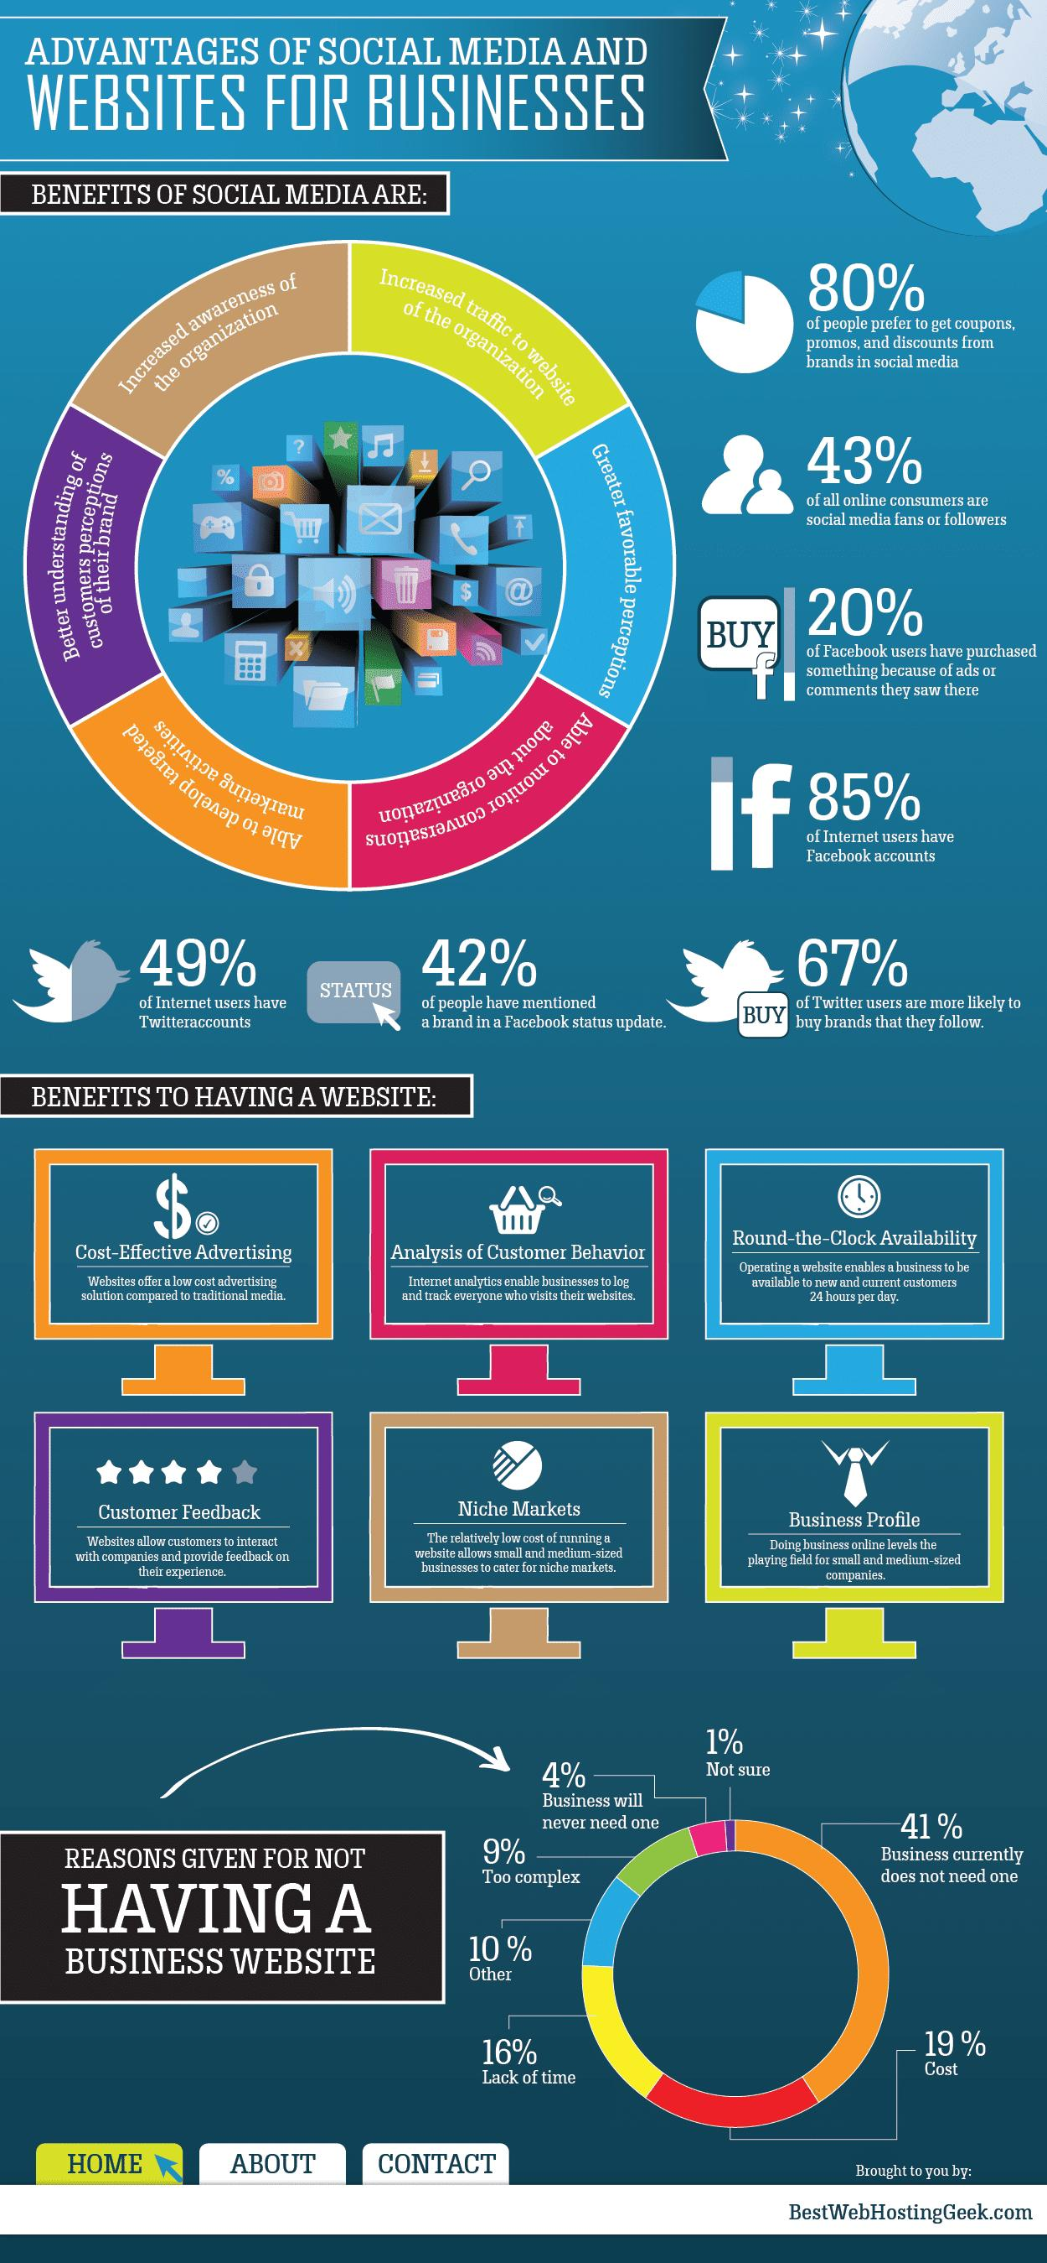

Slide 13
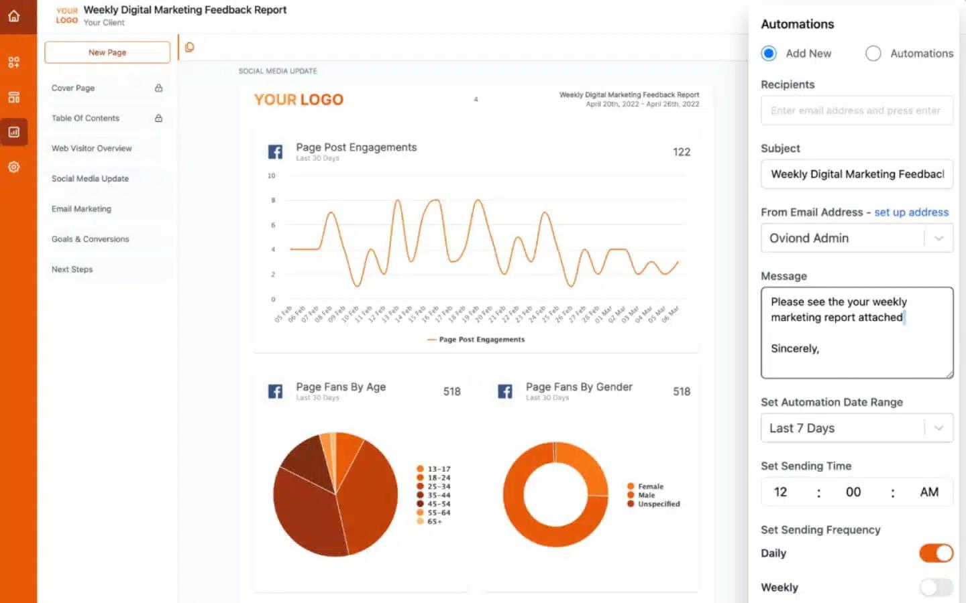
Craft Engaging Visuals :
Visuals can transform your social media analysis report from a data-heavy document to an engaging, easy-to-understand resource. Use charts, graphs, and infographics to represent data visually. This not only makes the report more appealing but also helps in conveying complex information more simply and effectively.

Slide 14
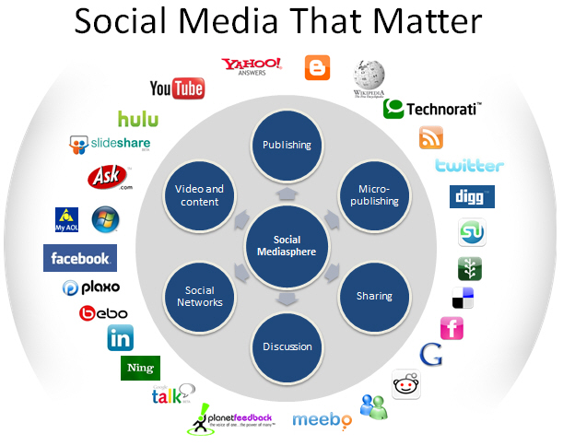

Slide 15
benefits of social media analysis:
1. Customer Service:
A major advantage of social media analysis is that it gives you the opportunity to finetune your customer service. How are your customers experiencing your brand? Does this differ from one touch point to the next? Customers are vocal about their interactions with brands, especially when they have negative experiences. Social media analysis can show you where your problem areas lie by providing insights into negative feedback and themes. This can help you improve your marketing or communications strategy, while also providing feedback to product development teams.
2. Competitor Analysis:
By identifying the activities, messages, and strategies employed by others in your industry on social media, you can gain a competitive advantage. For example, you can get insights into product launches for competing brands and assess how the market reacted, thereby giving you the chance to better plan for your own product launch. In addition, with ‘share of voice’ analysis, you can see how much of the media share you earned compared with your competitors, allowing you to see where you are beating them and where you can improve.

Slide 16
3. Crisis Management:
Many people now look to social media for breaking news. Viral stories are far more likely to ‘blow up’ on Twitter or Facebook than they are on television channels, for example. Receiving an analysis of peaks and troughs in social media mentions can help you see how the evolution of a crisis has unfolded. This gives you a sense of how to react in the future, which responses successfully downplayed negative coverage, how long you were in the spotlight for, and what the impact on your business was.
4. Campaign Tracking:
Did your influencers hit their targets? Do you want to know what people thought of your event? Social media analysis gives you insights to measure your campaigns and improve future activities. It can also help you evaluate the impact of campaign keywords or hashtags, as well as track the reach and effectiveness of your campaign – from pre-launch through to post-launch.
5. Content Creation and Distribution:
One of the best ways to create brand awareness is to initiate conversations around your activities, partnerships, products and services. With social media analysis, you are able to see which content types gain more traction than others, allowing you to adapt your content strategy going forward. In addition, by seeing a breakdown of locations and languages, you can use messages to target new markets that you never considered before.

Slide 17
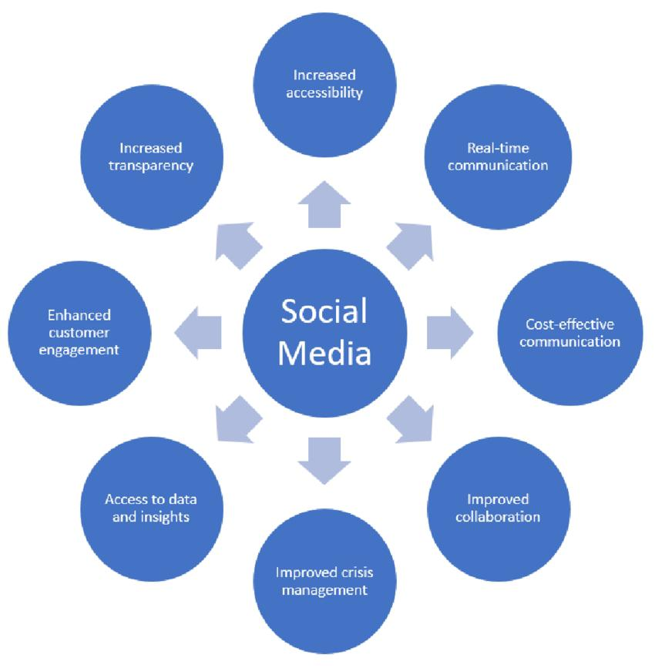

Slide 18
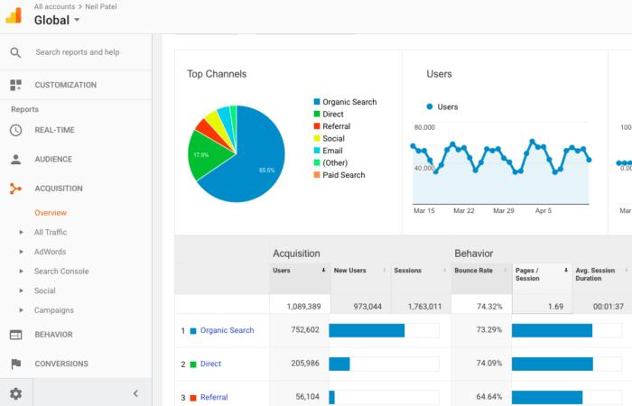

Slide 19
Conclusion ;
Businesses have taken up the social media platforms as a continuous, inexpensive and eﬀective method of communication and advertisement. The long term and constant monitoring of data metrics can help companies, in gaining knowledge about the customers from diﬀerent perspectives. This can further lead to high conversion rate and the retention rate of the customers . However, this requires a careful understanding and choice of the social media analytics tools and the constant monitoring of social media platforms . Available social media analytics tools should be mapped to the speciﬁc knowledge needs of the organisation and they should be implemented and monitored accordingly. Outcomes from the social media analytical tools need to be well understood and combined into the business strategy to reap their actual beneﬁts.

